Slide 1
Static Automated Program
Repair for Heap Properties
by Rijnard van Tonder and Claire le Goues
presented by Bruno Martins (bm2787) - COMSW6156 Spring 2019
Notes:
Hello everyone, my name is Bruno Martins, and I’ll be here today resenting the paper: Static Automated Program Repair for Heap Properties, which will talk about a method for automatically fixing certain kinds of bugs.

Slide 2
Problem statement
Notes:
Now I’d like to begin by spelling out the motivation for such paper. So, as we all know, It is a fact of life that

Slide 3
Problem statement
Programs have bugs!
Notes:
Programs have bugs! And often, they have lots of bugs

Slide 4
Problem statement
Programs have bugs!
Static analysis tools can find and report certain kinds of bugs
Notes:
Luckily, there are a number of tools that can help programmers in finding and squashing bugs. One class of bug finding tools available to us are static analyzers. These analyzers can find and report certain kinds of bugs back to the programmer. Not by running the code, but by examining the source code for potential issues. Note the keywords here -- find -- and report -- , typically,it is up to the programmer to evaluate that the bugs are in fact true positives and also, it is up to the programmer finding fixes to these defects.

Slide 5
Problem statement
Programs have bugs!
Static analysis tools can find and report certain kinds of bugs
What if a tool could also automatically fix the bugs it finds?
Notes:
Now, wouldn’t it be nice if there was a tool that *automatically* fixed the bugs that it finds? This is actually what this paper is about -- a tool that not only *finds* and *reports* bugs, but also proposes *fixes* to them --

Slide 6
Problem statement
Programs have bugs!
Static analysis tools can find and report certain kinds of bugs
What if a tool could also automatically fix the bugs it finds?
  Automated Program Repair
Notes:
This technique is called Automatic Program Repair. This paper presents a tool called -- FootPatch for performing automatic program repairs

Slide 7
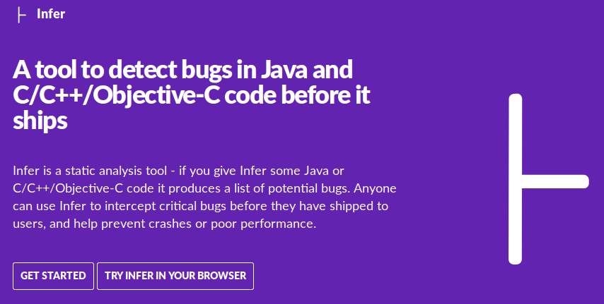
Background: Infer
Static analysis tool by
Facebook
Extensible
Works by converting
source code to an
Intermediate Language:
Smallfoot Intermediate Language (SIL)
Notes:
Now, we need to back up a little bit and talk about Infer. -- Infer is a static analysis tool built by Facebook. It’s quite an interesting tool. How it works is by way of converting source code in *any* of these languages here -- C -- C++ -- Objective C -- or Java -- and it converts them into this intermediate language, called Smallfoot Intermediate Language, or SIL for short.

Slide 8
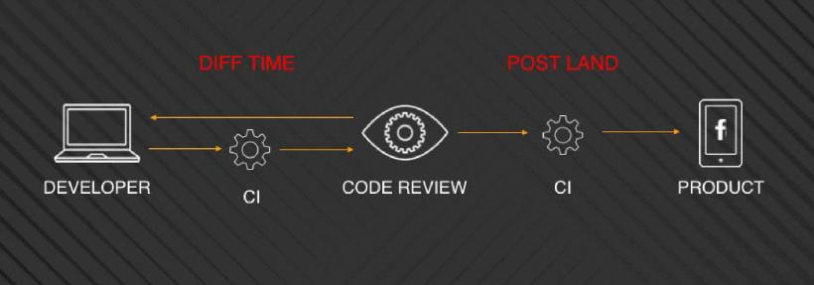
Background: Infer
Static analysis tool by
Facebook
Extensible
Works by converting
source code to an
Intermediate Language
One of the tools mentioned in “From
Start-ups to Scale-ups: Opportunities and
Open Problems for Static and Dynamic
Program Analysis”
Notes:
You may remember this tool. It was presented by the professor a few lecttures ago. -- Infer is mentioned in the paper “From Startuprs ---- now, remember that this tool runs on the left side of this diagram over here -- in facebook parlance, it runs at diff time, where it can catch bugs by merely analysing the code looking for issues, not by running it.

Slide 9
Background: Infer
Infer in action
Notes:
So, Infer’s website has this little gif -- that shows this tool in action. If I can pull it over here on the screen -- OK, take a few seconds to look at this code -- this is Java -- ahm, look at this code and think about what it does. -- This is a valid Java method -- there’s nothing wrong with it -- and all it does is return *either* a valid string -- or *null*. So if we run Infer on this piece of code, there shouldn’t be any issues. Lo a behold -- that’s a clean bill of health!
Now, the second part of this gif introduces a bug -- a *possible* null pointer exception.-- Take few seconds again and see if you spot the issue. ------ Now, observe the gif and note how Infer *caught* the potential bug and reported it. -- So, with that knowledge, the programmer has then to think about a solution, -- implement it, -- and then run the result through Infer again. --- Now as you can see, the bug is gone.
This paper will present a tool, -- again, called FootPatch, that does the last two steps automatically for you. -- This is an extension to Infer, that’s why I am talking about Infer *first*.

Slide 10
Background: Separation Logic
Infer works by using Separation Logic to extract specifications from each command in the source code, which can then be composed into procedure summaries.
  Separation Logic: formal way to reason about a program’s manipulation of its state (memory)
  Specification: a triplet in the form:
    {P}C{Q} where P is the current heap state, C is the command being considered and Q is the heap state after C executes
  Procedure summary: the summary of the combined effects of all of the procedure’s commands.
Notes:
Now, take a deep breath. -- I am going to talk about the *theory* underpinning Infer. -- Let’s start by talking about Separation Logic. -- Here we go. (read the first sentence). Let’s go by parts: separation logic is the name of the theoretical framework that allows u to reason about a programs manipulation of its state, or, -- in other words -- its representation in memmory. -- A specification in Separation logic is a triplet in the form P C Q where P is the *current* heap state, C is the command being considered and Q is the heap state after C executes. Procedure summary

Slide 11
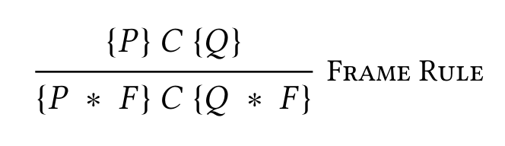
Background:
The Frame Rule states that, given a heap H, the analysis of the command C with specification {P}C{Q} can proceed without considering the unaffected parts of H, namely the frame F.
This enables local reasoning: the ability to reason only over the affected heap parts and ignore the rest.
The process by which a frame F is found is called frame inference.
The affected part is called footprint.
Notes:
Another piece of theory that I want to talk about is the -- Frame -- Rule. - Consider a heap H. The frame rule states that, given some heap H, the analysis of the command C with speciffication P C Q can proceed withouf considering the unaffeccted parts of the heap = -- we will call the unnafeccted parts of the heap the frame F. Now, this is a lot of words that mean essentuialy that we can ignore *everything else* going on in the program and worry only about the effects of the comand C.
This is called local reasoning. And intuitively, this what we, programmers, naturally do when thinking about programs.
Frame inference.
Conversely, if the unaffected part of the heap is called FRAME, the *affected* part is called footprint

Slide 12
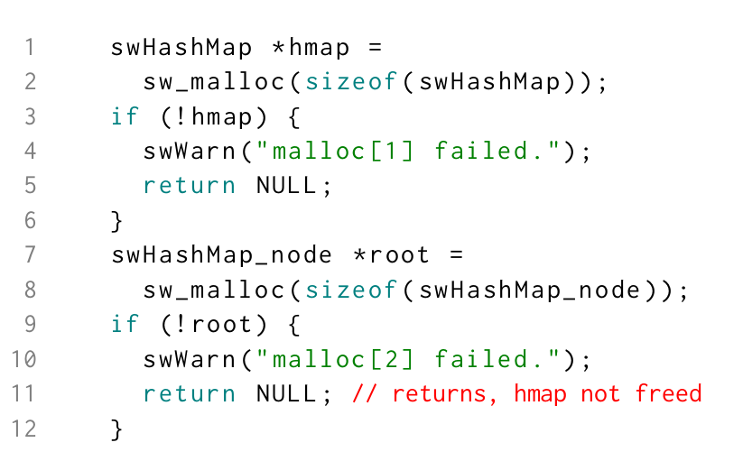
Background: Example
{hmap⇒undefined, root⇒undefined}
hmap=sw_malloc(...)
{hmap⇒alloced, root⇒undefined}
Notes:
(Swoole is a popular event-driven networking engine for PHP)
Let’s look at an example from the paper to try to clear things up. -- Look at lines one and two in the code snippet down here. -- What is this statement doing? -- It is allocating memory through a custom allocator sw_malloc and storing the pointer to the allocated heap memory into the variable called hmap.
For this particular statement, How does the frame rule apply? First, note that *before* the statement both hmap and root are undefined -- they don’t exist. After this statment executes, hmap will be defined, but root won’t.
According to the frame rule, in this situation, what is the Frame, and what is the Footprint?

Slide 13
Background: Example
{hmap⇒undefined, root⇒undefined}
hmap=sw_malloc(...)
{hmap⇒alloced, root⇒undefined}
Frame (F): { root }
Footprint: { hmap }
Notes:
In this case, for this particular statement -- the Frame is composed by root and the footprint is composed by hmap
The frame rule tells us that we can completely ignore the variable root when analyzing this statement.

Slide 14






Background: Separation Logic
Armed with Separation Logic, Infer finds bugs by looking in its symbolic representation of the program for certain problematic specifications
For example, it can find the memory leak in the previous code snippet
Let’s use the notation to mean that the interpretation step
for instruction at location in symbolic state results in a
Notes:
Now, by using separation logic, -- Infer goes on looking for bugs in the symbolic representation of the program. For example, it can find memory leaks as the one in the previous slide.
For this part, lets look at the notation Cee subscript el, sigma squigly arrow fault. This means that the *interpretation step* squigly arrow, for the instruction C at the location l in the source code, with symbolic state SIGMA leads to a fault.
In other words, if you execute C when the heap state is sigma, you will get a fault

Slide 15
Background: Example
In this example, at the location l=11:
return_{l},{hmap⇒alloced} → fault
Notes:
Now, for this example, l is equal to 11 because the command being considered is on line 11 on the source code.
For this case, the command C is return, the heap state sigma is equal to hmap being allocated and the execution of this command will cause a fault. Why? Because in this case, memory will be leaked. Hmap should be freed before returning

Slide 16
Background: Example
In this example, at the location l=11:
return_{l},{hmap⇒alloced} → fault
At this point, Infer would report the bug.This is where FootPatch comes in.

Slide 17
FootPatch
FootPatch is an extension to the Infer tool, created by the authors of the paper
It deals with three heap-based properties violations:
  Null dereference
  Resource leak
  Memory leak
Once Infer finds a violation, FootPatch tries to repair it based on other similar snippets from elsewhere in the code.
Notes:
Key insight of this paper

Slide 18
What is a Repair
A repair satisfies:
Where T is an additive transformation in the form of a program fragment that avoids the fault state.
Notes:
But what is a repair? A repair satisfies the following ----- given a command C at location l with a bad heap state, that will lead to a fault, -- FootPach will try to find a repair -- here represented by T -- applied at line l prime -- SUCH THAT the heap will be in a OOD state when C is evaluated and it WON’T lead to a fault state.

Slide 19
Repair specification
{F}C_{R}{F’} where:
F: error heap configuration
C_{R}: repair fragment
F’: fixed heap configuration
Notes:
Now this is a little bit more notation. This is a repair specification

Slide 20
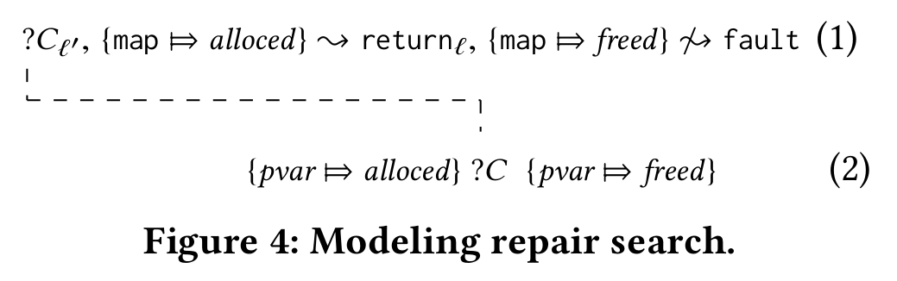
Repair search
Notes:
THis is an example of how FootPatch searches for repair -- Here, it is looking for a command C that takes a variable (here a free variable called pvar) from the state allocated to free.
Foot patch finds the repair above

Slide 21
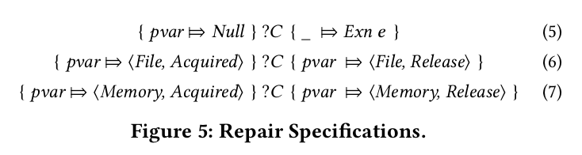
Repair queries
Notes:
These are the three repairs that FootPatch looks for.
For null dereferences, it looks for code that throws an exception
For acquired resources, it looks for code that releases the resource
For acquired memory, it looks for code that frees it

Slide 22
Repair queries
A key insight from the paper is that the queries can be relaxed to capture extra semantic effects by applying frame inference on the pre- and post-conditions to candidate repair fragments.

Slide 23
Repair location
Few locations possible
Notes:
WHere should the repair be put? In this example, it could be put *either* before line 10 or before line 11. The researches found that usually putting the repair right before the leak occurs is the best place.

Slide 24
Repair location
Few locations possible
In this example, the fix could be applied either before line 10 or before line 11
FootPatch chooses the line immediately before the fault-causing statement
In this case, between lines 10 and 11.

Slide 25
Generating the patch
Infer’s Smallfoot Intermediate Language (SIL) carries type information in its symbolic statements
Therefore, FootPatch can use that type information to decide which repair to use
In this case, sw_free is used instead of free, since hmap is of type swHashMap
Notes:
One interesting feature is that, since SIL carries type information, FootPatch can infer that the fix should be the applocation of the custom deallocator sw_free, rather than the generic free, since it pulled this information from elsewhere in the code.

Slide 26
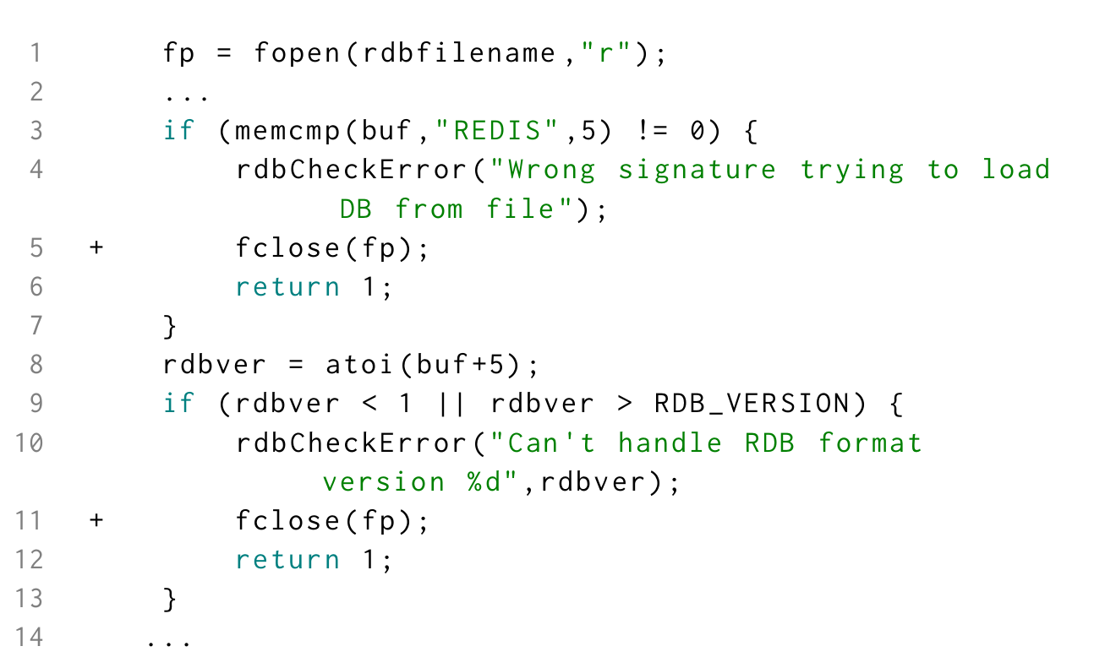
Finding more bugs
Notes:
Another interesting finding by the researches is that -- by running FootPatch to automatically find bugs -- in this case, the bug at lines 5-6, -- NEW bugs would be found, later at lines 11-12. Infer would short-circuit its analysis to the first bug in this snippet, but y runing FootPatch in a first pass the second bug was discovered.

Slide 27
Correctness
How to verify that a patch was successful:
Apply it and run Infer again: should result in the bug not being found
Run the project’s test suite
Notes:
How does FootPatch know that the patch was correct? FootPatch automatically applies the patch and runs Infer again, to see if the bug vanished. The researches also tried to run the tests of the projects they were using for testing, with varying degrees of success.

Slide 28
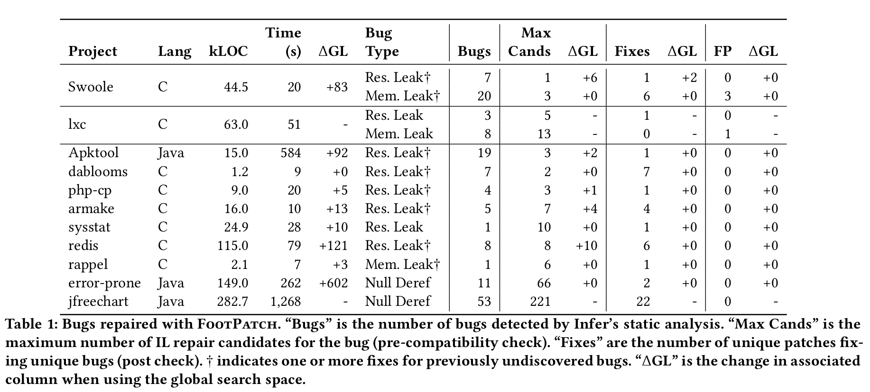
Results
Notes:
So this is a summary of the projects that were subjected to FootPatch. There are some big projects -- like redis and jfreechart -- and small ones like dablooms. I won’t go into detail, but the paper claims that footpatch AUTOMATICALLY found and fixed
54 of the 145 bugs it found, excluding false positives, which is pretty impressive in my opinion.

Slide 29
Thank you!

